Slide 1
Scraping Google
Bailey Wallen, Vishwanath Prathikanti, James Hizon, and Shivam Mistry
(AKA. Group Cheese and Crackers)

Slide 2
Introduction
Class Overview and class research question
Project development
Final data analysis
Individual research questions
Notes:
Bailey
For the introduction, be sure to describe the larger project briefly and focus mostly on the specific question(s) your group investigated
Questions:
How is research divided up amongst the science departments at UC Davis? -- Bailey
How UC Davis helps women thrive in STEM? -- Vishwanath
How is diversity divided and accommodated across the UC Davis STEM Portal? -- Shivam
What

Slide 3
Methods
Primarily used Nested for-loops and nested trycatches
Nested for-loops
Outermost for-loop goes through every primary URL
Inner for-loop goes through every secondary URL
Nested trycatches
Outermost trycatch catches bad links in the list of primary links
Innermost trycatch catches bad links in the list of primary links
Notes:
vish

Slide 4
What kind of topics should we expect most of our research to be related to?
Using the Intertopic Distance Map in combination with most salient/relevant terms.

Slide 5
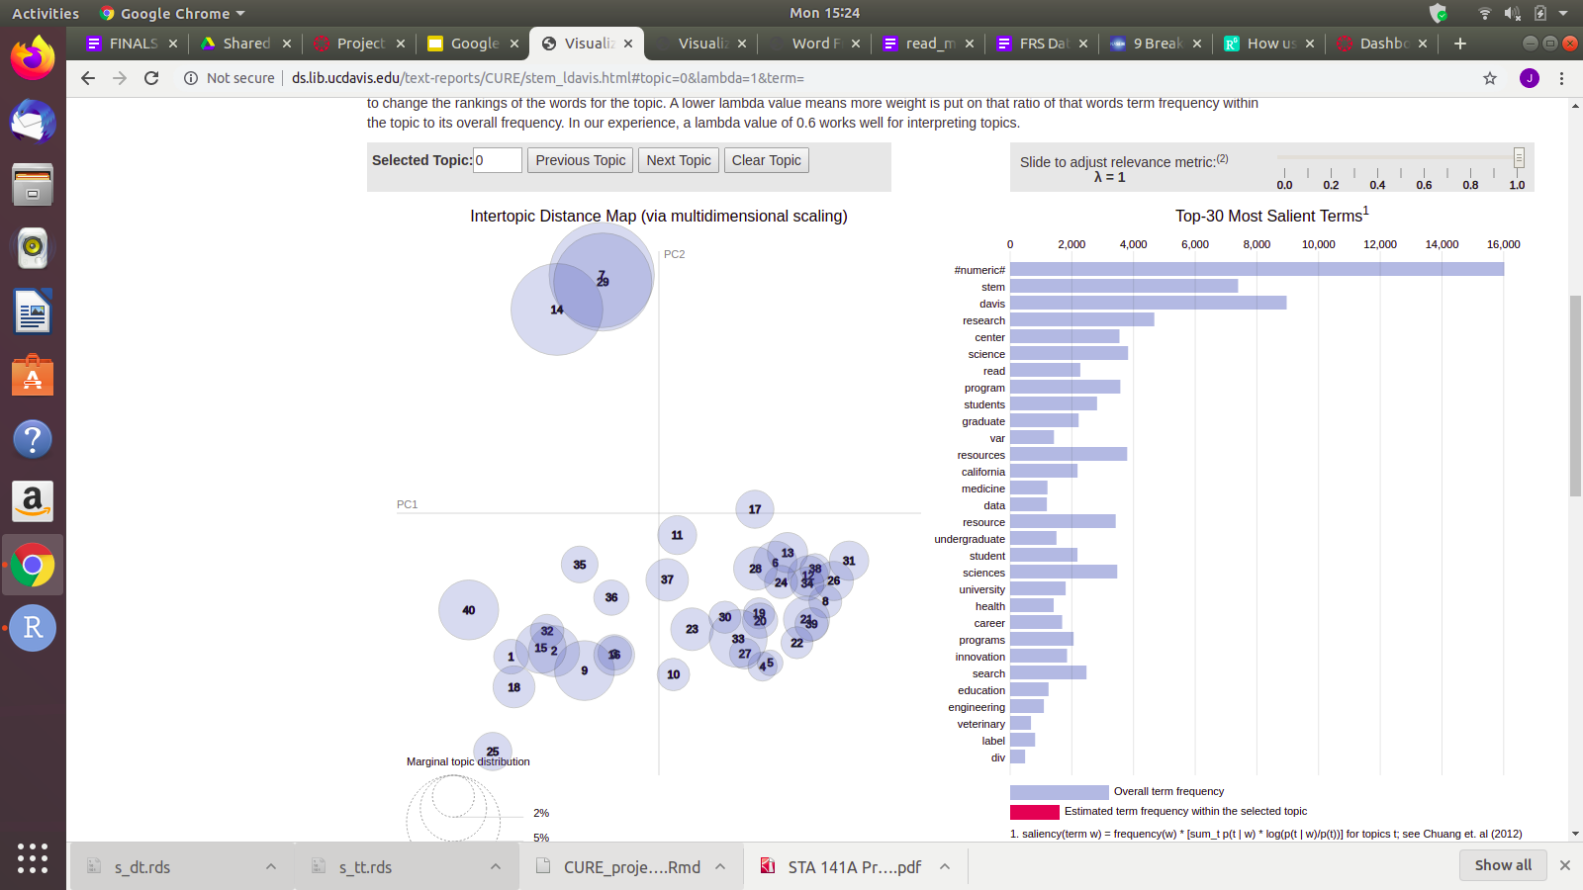
Interpretation
Using an Intertopic Distance map to observe representation of all terms inside STEM Portal by topic.
NOTE: Each circle represents a unique topic.
Notes:
You may need multiple slides for the results/interpretation

Slide 6
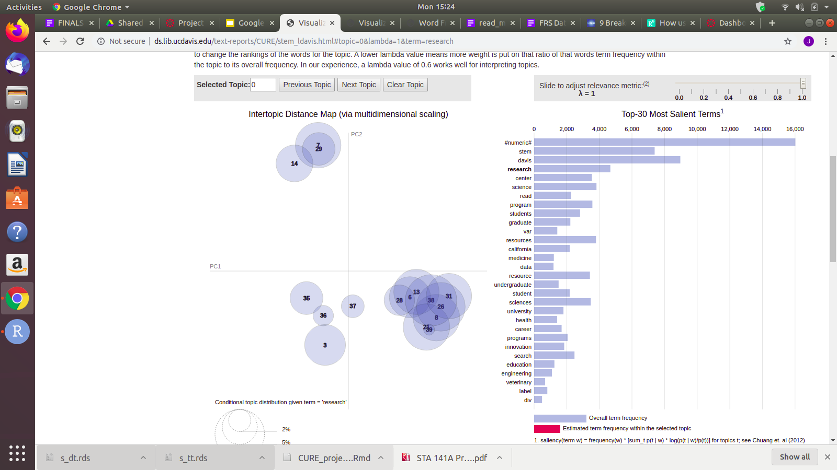
Grouping By Term: “Research”

Slide 7
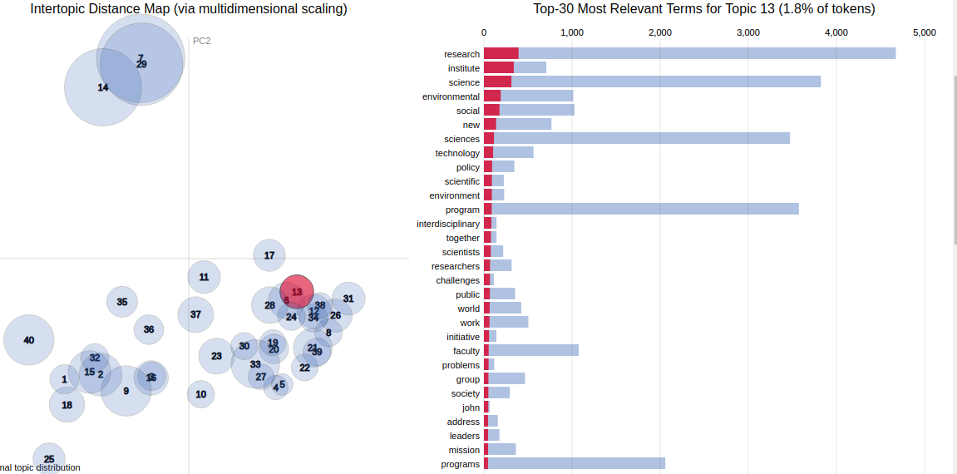
Topic 13: Research for the Environmental Sciences

Slide 8
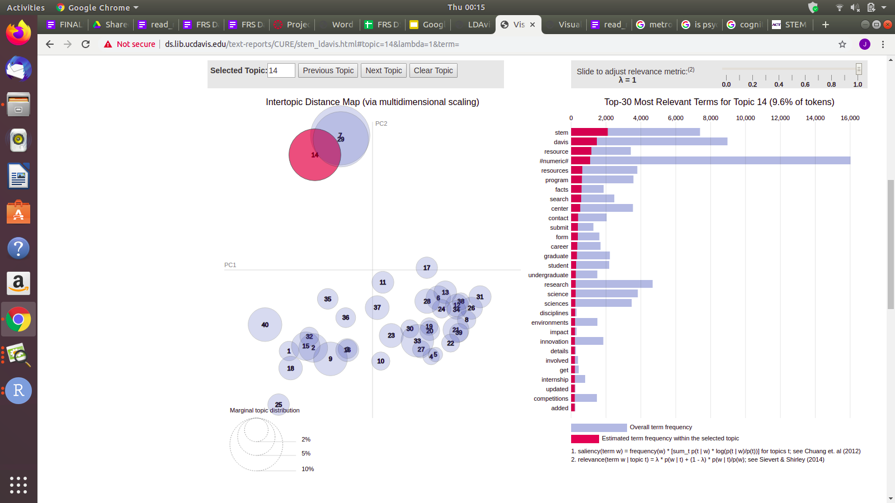
Topic 14: Resources to aid in Research Involvement

Slide 9
Recommendation
Based off a single topic in our topic analysis, because the representation of Topic 13 is quite small, compared to say, Topic 14, it can suggest a need to include more research in the area of environmental sciences across disciplines in the near future.

Slide 10
UC Davis and women in STEM
Research question: How is UC Davis encouraging women in STEM?
Method to answer: Find gendered words in word frequency table and interpret if UC Davis is fostering a healthy environment for women in STEM

Slide 11
Results
Out of the 461 pages scraped,
“women” appeared 110 times, “woman” appeared 3 times, “women’s” appeared 27 times, “womens” appeared 497 times, and “female” appeared 42 times
“mens” appeared 497 times, “male” appeared 15 times, and the other male equivalent words (“man”, “men”, “men’s”) appeared 0 times.

Slide 12
Interpretation
When it comes to Research opportunities in STEM and in general, UC Davis is doing well to foster an environment that is oriented towards women succeeding in STEM.
Apparent that UC Davis is making an effort to increase feminine participation in STEM

Slide 13
Recommendations
A bit too broad scope of the data for big recommendations
Scraped every google search with “uc davis research centers” that had domain belonging to ucdavis.edu
This means gendered words could be part of research opportunities, research data
Could come from things like sports, where gendered words are similar in frequency
Word frequency data does not show what words came before/after
Recommendation: make the UC Davis CAMPOS website more apparent/relevant
“CAMPOS” (Center for Advancement of Multicultural Perspectives on Science) appeared 0 times in the word frequency program

Slide 14
How is diversity divided and accommodated across the UC Davis STEM Portal?
Methods to find answer:
Looked at the STEM portal and the UC Davis Academic STEM website.
Provided a search for diversity and related words in word frequency table
Developed an interpretation and analysis based on the searches.

Slide 15
Results
Of the 461 pages scraped:
“Diverse” appears 51 times
“diversity” appears 41 times
“International” appears 600 times
“National” appears 354 times

Slide 16
Interpretation
When it comes to Research opportunities in STEM and in general, UC Davis is doing ok in providing an environment that leads all diversity in prospering in STEM.
It is apparent that UC Davis STEM is increasing its efforts in providing a program for all diverse groups.
The results show a wide program for international students, which is good. Though when going into specific, less diverse groups are seen available, including the info specific to them.

Slide 17
Recommendation
The UC Davis STEM portal should accommodate diversity more. While it does have a significant resource identifying “international” students, the portal should grasp more specifics.
More links and programs should be readily available for these diverse groups so there is more equal opportunity for all diverse groups.

Slide 18
How is research divided up amongst the science departments at UC Davis?
looked at STEM portal data as well as Academic Department data
Made inferences
Explained observations through analysis

Slide 19
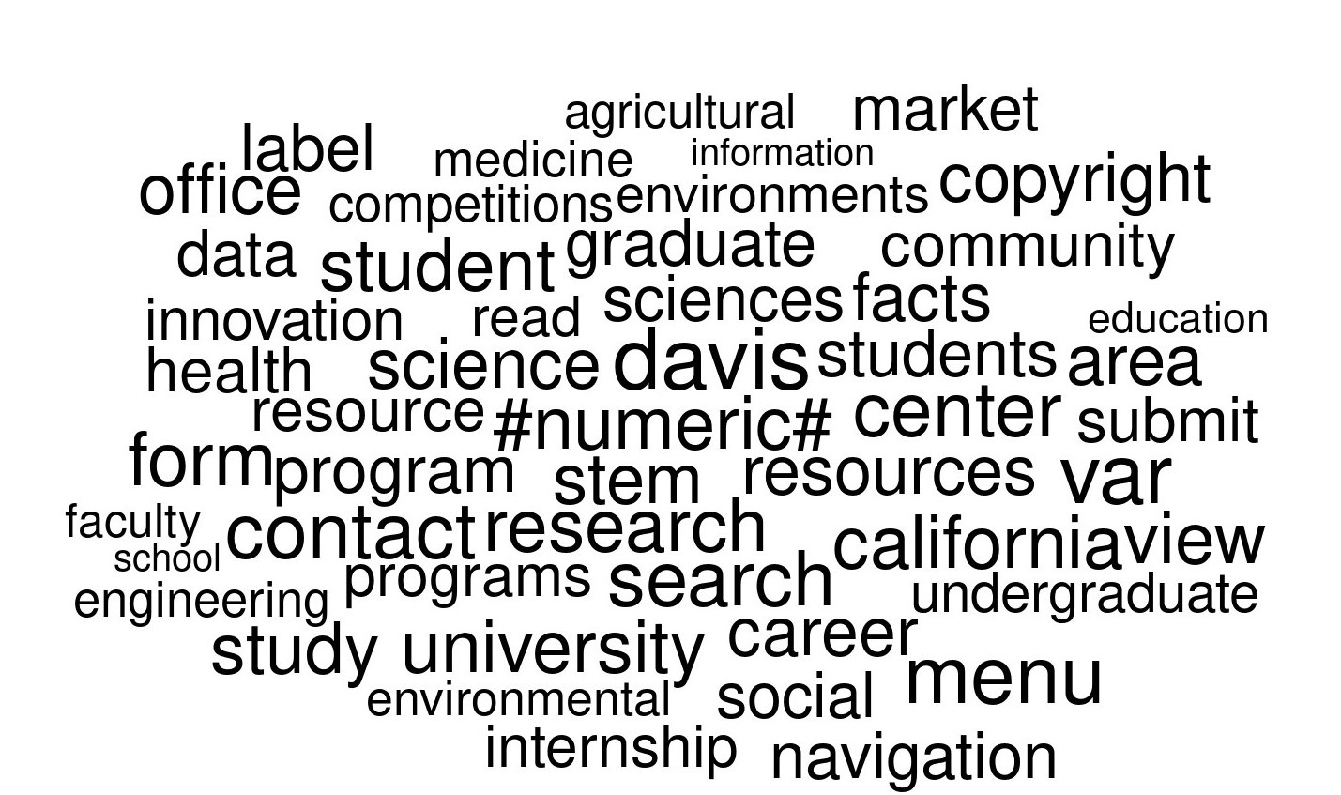
Notes:
This is the Stem portal data and it shows

Slide 20
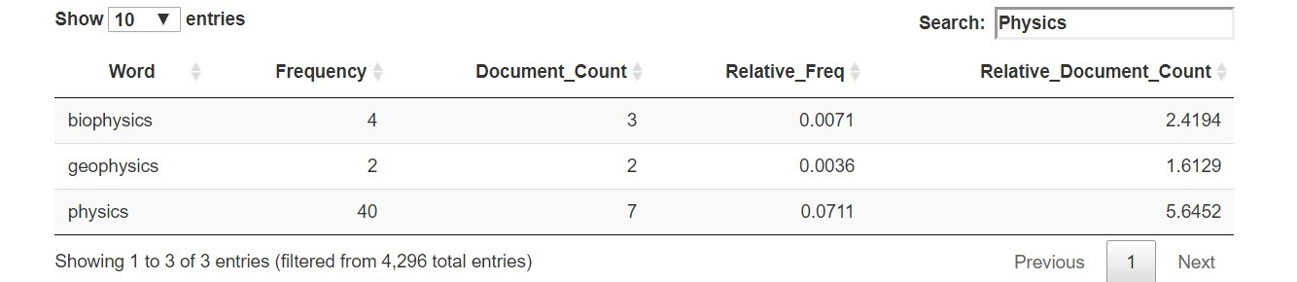
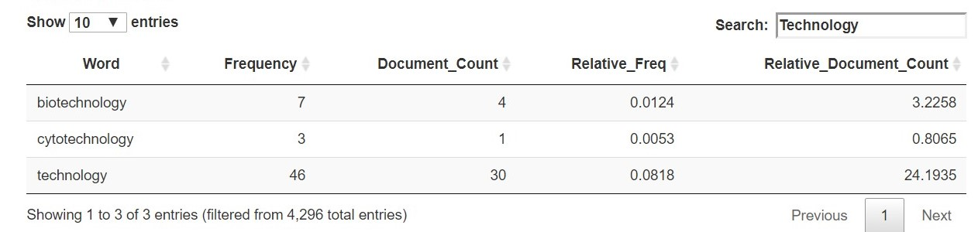

Slide 21
What does this show?
STEM Portal is missing departments
Representing Davis as a Biological, Agricultural and Engineering institution

Slide 22
Recommendations
Two options each depending on how the school wants to be represented
Davis focuses on Biology, Engineering and Agriculture
Davis represents a broad range of research
Caveat: Our research may not be an accurate representation of STEM Portal

Slide 23
Defeats
Not knowing the programming language
Not knowing what was wrong with the primary for loops
Not knowing how to write for-loops and trycatches
Difficulty understanding webscraping
Notes:
each person in your group should mention one personal "defeat" and one "victory."
Defeats are things that frustrated you, things you wish you could have figured out or done better.

Slide 24
Victories
Communication skills
Figuring out the problem with the nested for-loop
Code working without errors after troubleshooting
Understanding and being able to write code for cleaning
Notes:
each person in your group should mention one personal "defeat" and one "victory."
Victories are things that you discovered that were really neat, something that surprised you (in a good way!), or accomplishments that made you proud.

Slide 25
Thank You
Questions?

Slide 26
Bailey Wallen (bswallen@ucdavis.edu)
Vishwanath Prathikanti (vprathikanti@ucdavis.edu)
James Hizon (jrhizon@ucdavis.edu)
Shivam Mistry (smistry@ucdavis.edu)

